Slide 1
SuperNEMO sensitivity estimates for BSM physics
Maros Petro

Slide 2
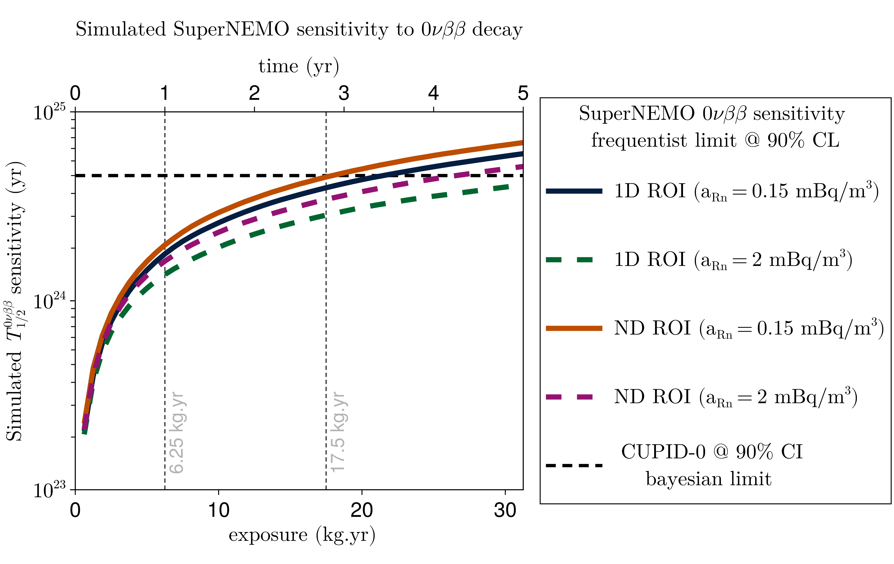
0nubb

Slide 3
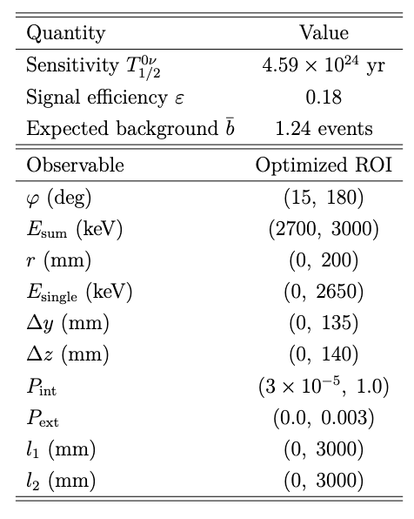
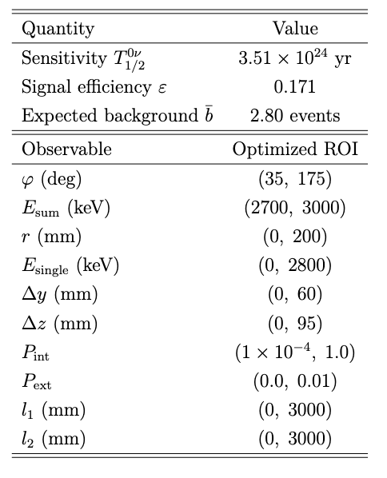
0nubb comparison ND ROIs
Radon 0.15 uBq/m3
Radon 2 mBq/m3

Slide 4
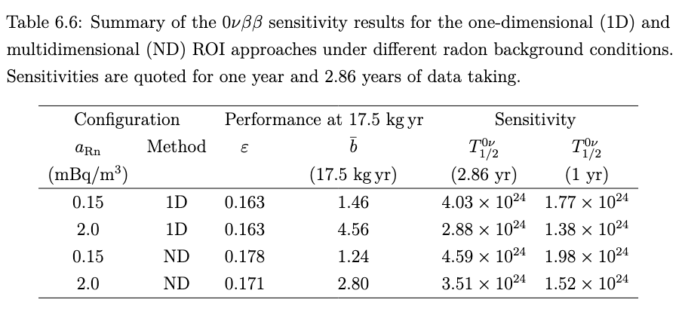
0nubb comparison ND vs 1D + high vs low radon

Slide 5
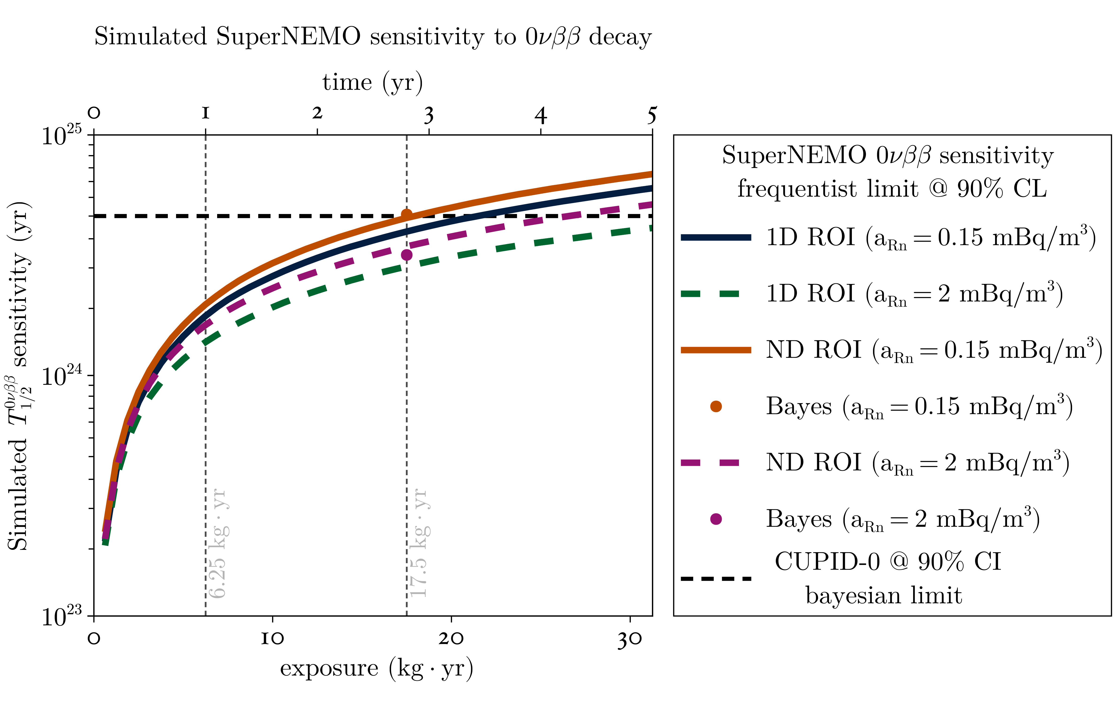
0nubb with Bayes limits

Slide 6
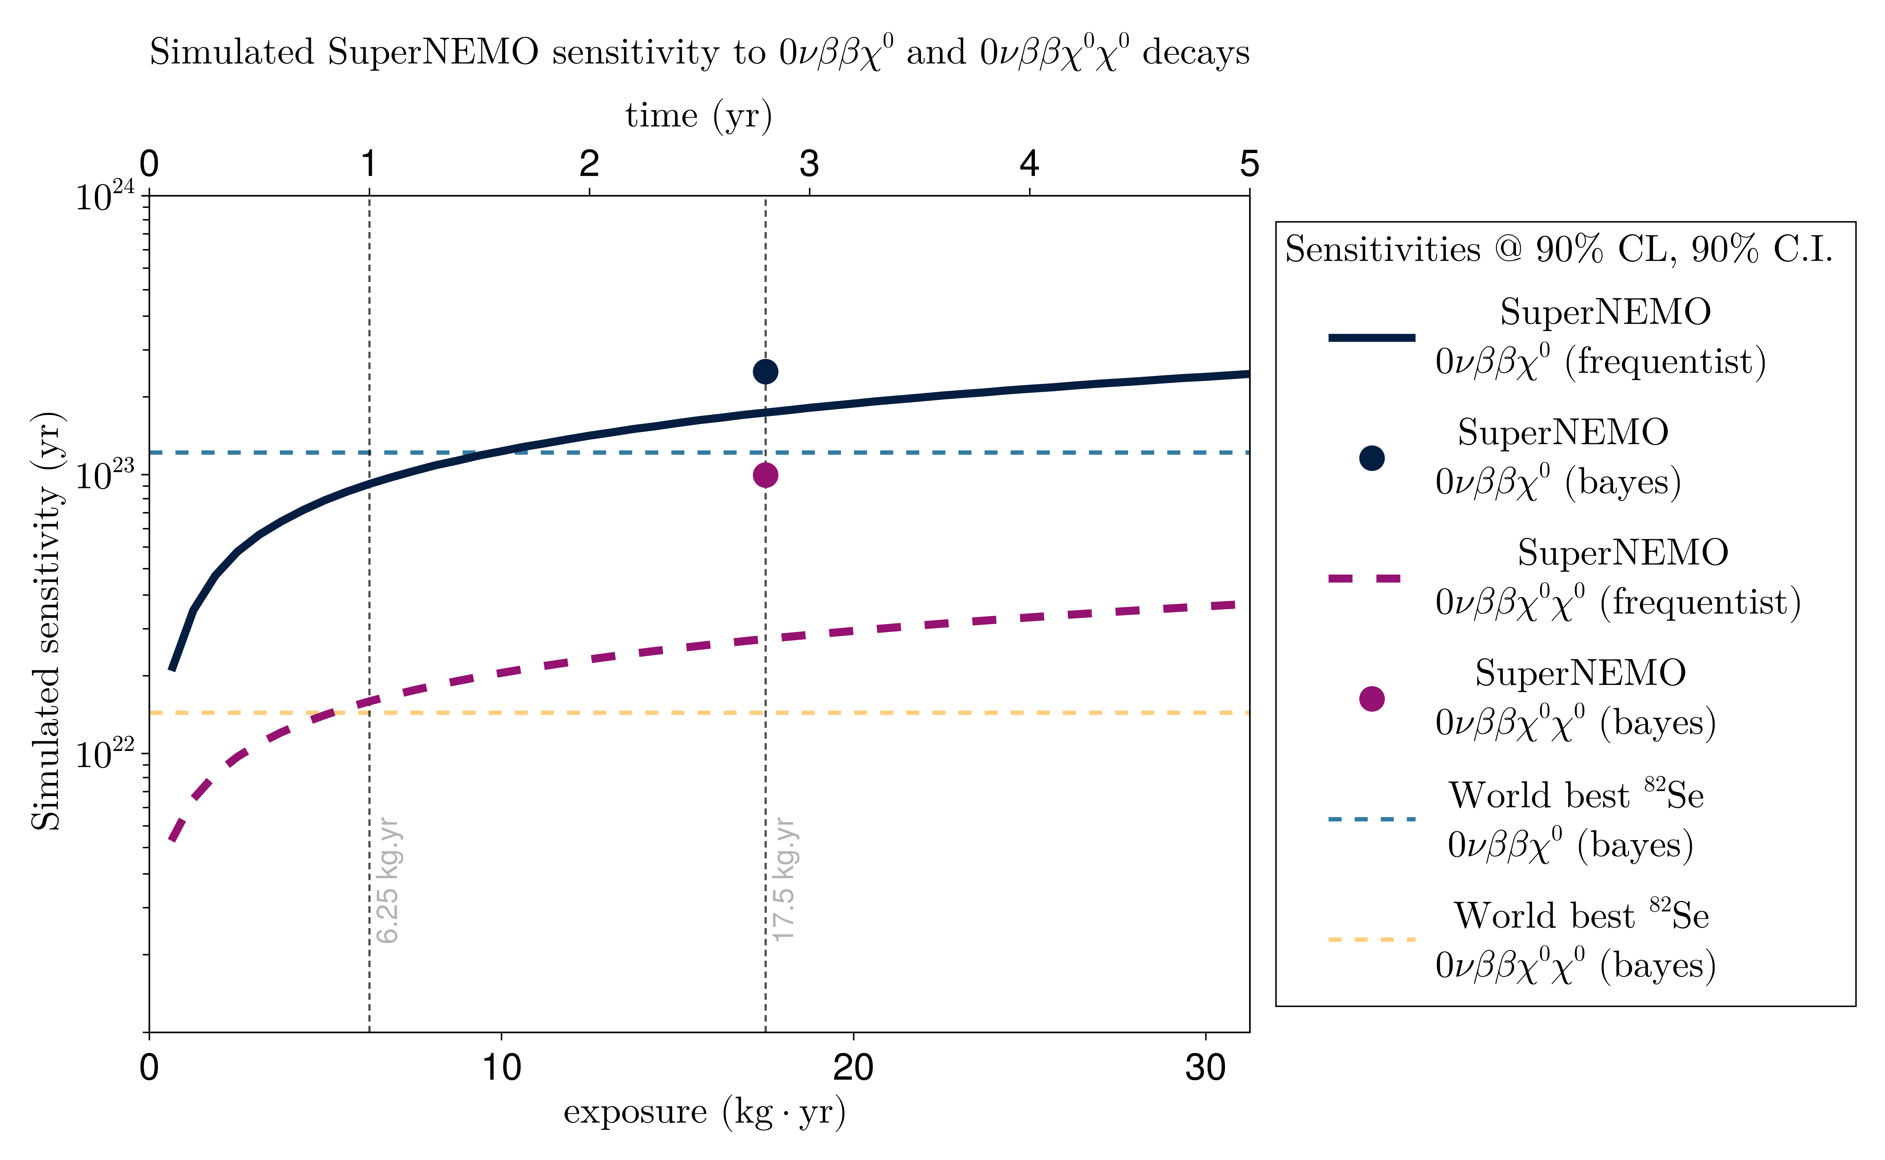
Majoron modes

Slide 7
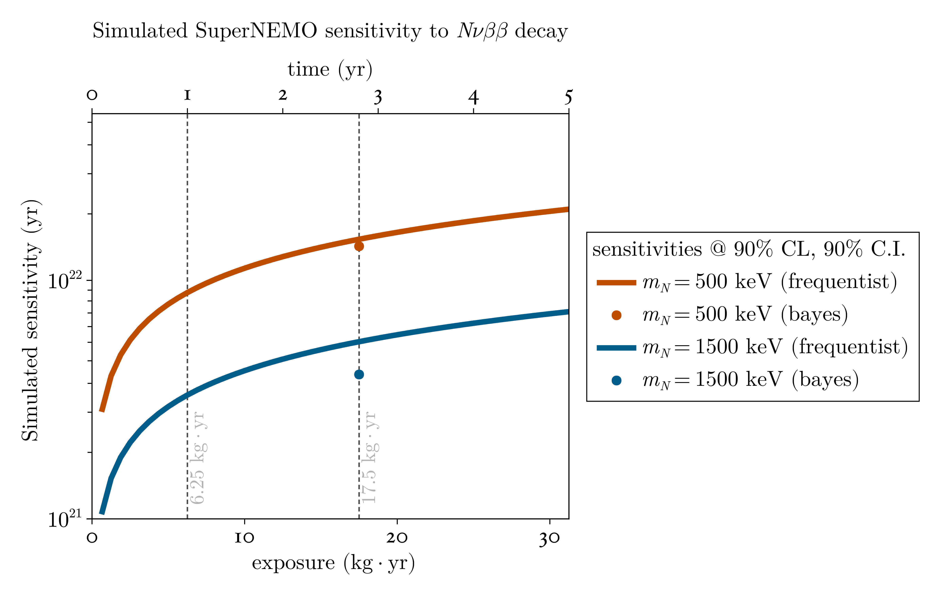
Sterile neutrino with masses 500keV, 1500keV

Slide 8
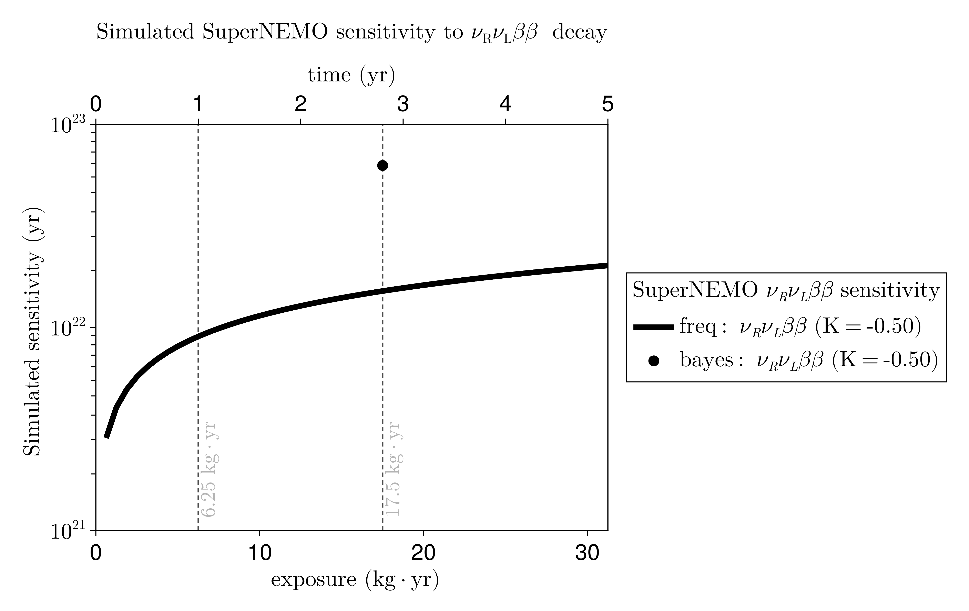
2nubb with right handed neutrino

Slide 9
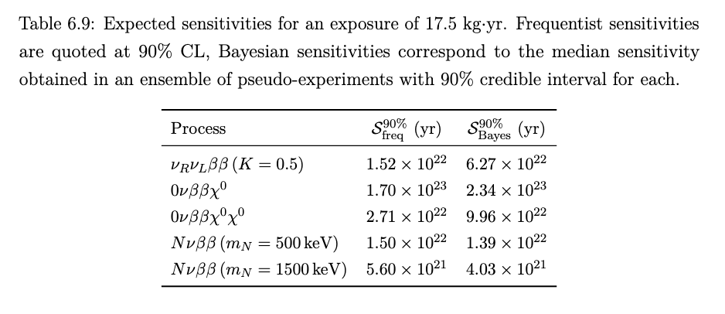
BSM sensitivities

Slide 10
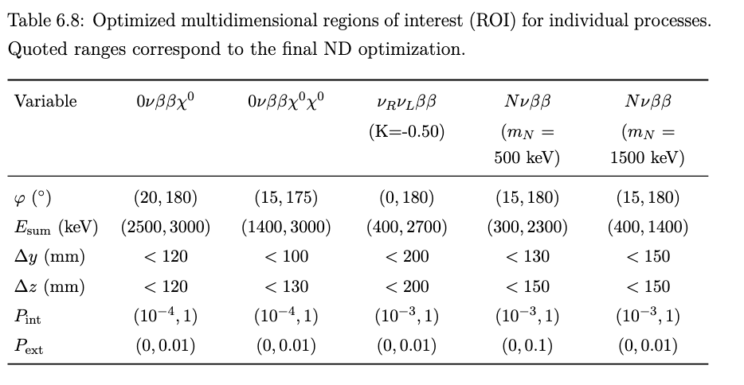
BSM ROIs

